Slide 1
Pedestrian Detection
for Mobile Platforms
Jonathan Shen Noranart Vesdapunt
jshen2@andrew.cmu.edu nvesdapu@andrew.cmu.edu
Supervisor Kris Kitani
Sponsor Carnegie Robotics
Carnegie Mellon University
Notes:
Hello, my name is Jonathan and this is my teammate Noranart.
Our project is Pedestrian Detection for mobile platforms, our supervisor is Kris Kitani, and the project is sponsored by Carnegie Robotics.

Slide 2
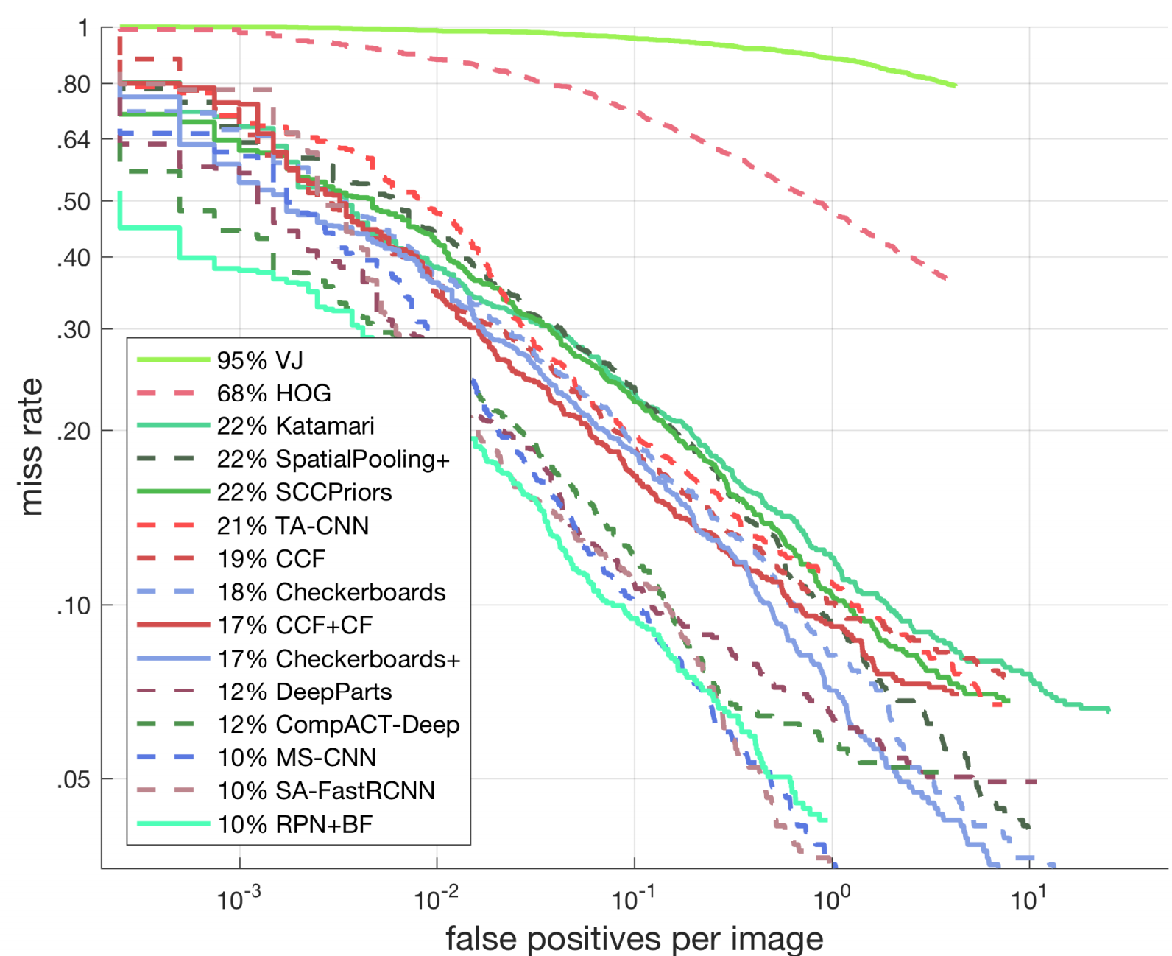
Pedestrian Detection
Caltech Dataset (Reasonable)
Pedestrian detection is a well-studied problem!
Over 50 different approaches have been evaluated on Caltech
Only 10% log-average miss rate (lower is better)
Pedestrian Detection: An Evaluation of the State of the Art, Dollár, et al., 2012
Notes:
Pedestrian detection is a very well-studied problem, with over 50 different approaches evaluated on the Caltech Pedestrian Detection Benchmark.
The plot on the right show the results of some of them for the Reasonable configuration.
On the X-axis is the number of false positives per images, and the Y-axis is the percentage of pedestrians that are missed.
The lines are slanted downwards because well, if you want to detect more people, then the number of false positives will also increase.
The box reports the log-average miss rate, which is the average miss rate with respect to the log of the number of false positives per image. A lower number is a better result.

Slide 3
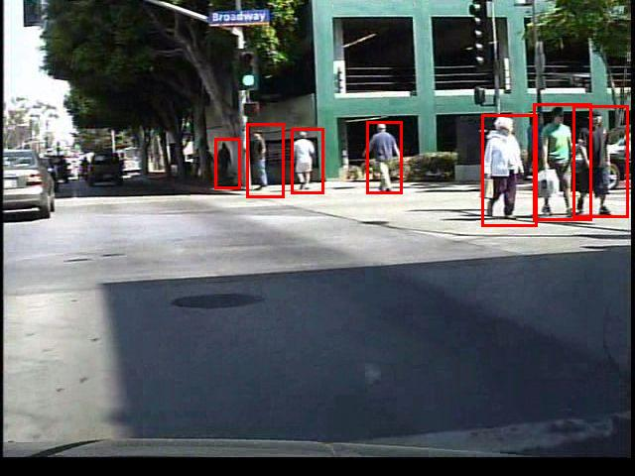
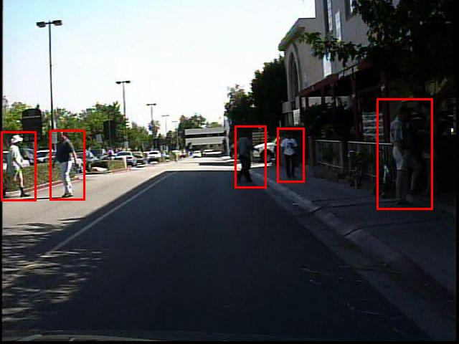
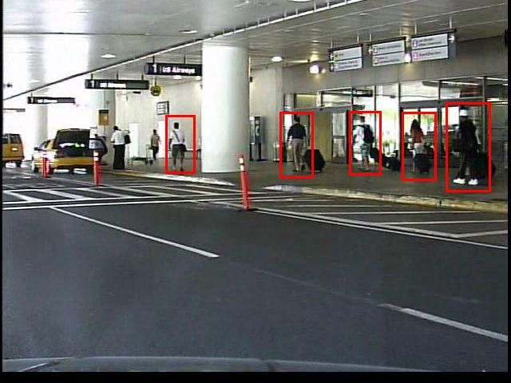
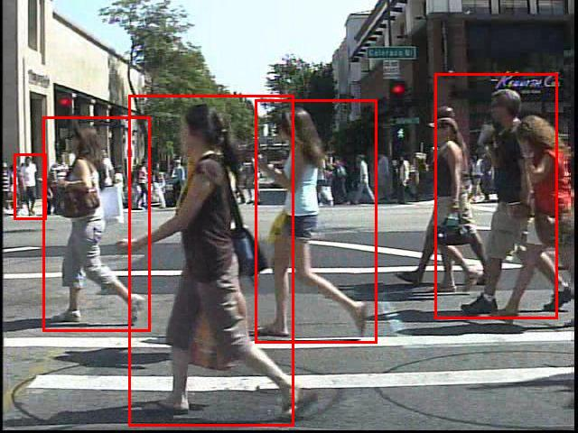
Caltech Pedestrian Detection Benchmark
10 hours @ 640x480
~250,000 frames annotated
~2,300 unique pedestrians
Reasonable configuration:
50-pixel or taller
unoccluded or partially occluded
box mainly contains a single person
Pedestrian Detection: An Evaluation of the State of the Art, Dollár, et al., 2012
Notes:
The Caltech Dataset contains around 10 hours of videos featuring over 2000 unique pedestrians.
Here are some examples of ground truth boxes for the Reasonable configuration, which is defined as being at least 50 pixels tall and mostly unoccluded.
I don’t know if you can see, but there are small pedestrians and crowds of pedestrians in the background that don’t have boxes around them because we don’t care about detecting them.

Slide 4
Pedestrian Detection
Caltech Dataset (Reasonable)
All involve deep convolutional network
File size > 1 GB
Parameters > 50 million
Pedestrian Detection: An Evaluation of the State of the Art, Dollár, et al., 2012
Notes:
There has been a lot of development recently in pedestrian detection. In fact, the top 5 methods were all published within the last 2 years, and all use deep learning.
But the networks they use are very large, containing tens to hundreds of millions of parameters.

Slide 5
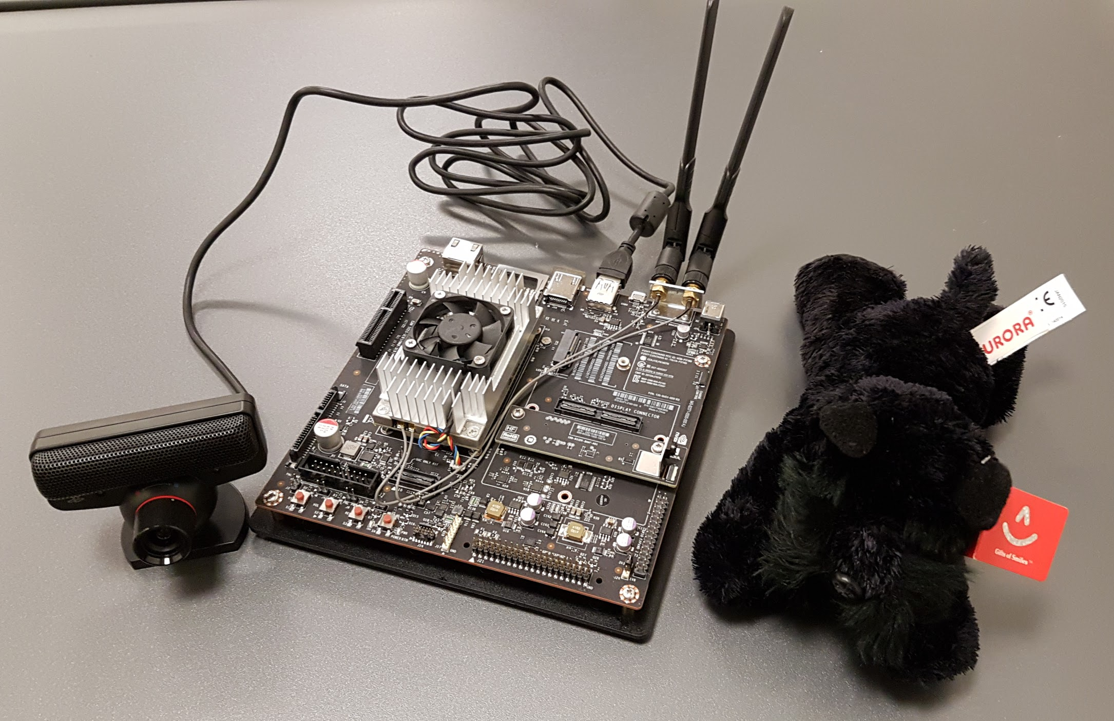
Problem Statement
Goal
produce a system capable of detecting and localizing nearby, potentially occluded pedestrians under reasonable lighting conditions, that can be run on mobile platforms
Approach
deep learning, but we cannot hope to just put large networks on the board ⇨ Create a smaller network based off of an existing large network
Notes:
The goal of our project is to produce a system for pedestrian detection that can be run on mobile platforms.
The picture is the NVIDIA Jetson TX1 board that we use to test our system.
Given how well deep learning was doing, we also wanted to use deep learning, but we couldn’t just take one of the state-of-the-art networks and put it onto the board because there wouldn’t be enough memory, and even if there were enough memory it would be too slow.
So instead, we wanted to somehow create a smaller network.
1 TFLOP 256-core Maxwell GPU, ARM A57 CPU, 4GB Memory

Slide 6
Network Compression
Notes:
So, let me talk briefly about network compression.
There has been a lot of research into compressing neural networks, especially recently.

Slide 7
Network Pruning
“Directly remove parts of the network”
Comparing biases for minimal network construction with back-propagation Hanson et al. 1989
Optimal Brain Damage LeCun et al. 1990
Optimal brain surgeon and general network pruning Hassibi et al. 1993
Data-free Parameter Pruning for Deep Neural Networks Srinivas and Babu 2015
Notes:
One of the more classical ideas is pruning. By removing connections and neurons with low impact, the size of the network can be reduced.

Slide 8
Parameter Sharing
“Group similar numbers together”
A deep neural network compression pipeline: Pruning, quantization, huffman encoding Han et al. 2015
Compressing Convolutional Neural Networks Chen et al. 2015
An Exploration of Parameter Redundancy in Deep Networks with Circulant Projections Cheng et al. 2015
XNOR-Net: ImageNet Classification Using Binary Convolutional Neural Networks Rastegari et al. 2016
Notes:
A complementary idea is to group similar parameters together with hashing or bucketing.
Taking this to the extreme, you can even try to approximate all of the filters with just 0s and 1s.

Slide 9
Matrix Decomposition
“Treat weights as matrices and apply matrix decomposition”
Predicting Parameters in Deep Learning Denil et al. 2013
Tensorizing Neural Networks Novikov et al. 2015
Towards Convolutional Neural Networks Compression via Global Error Reconstruction Lin et al. 2016
Notes:
A more mathematically inspired approach is to apply matrix decomposition on the weight matrices.

Slide 10
Towards a "smaller" network
Previous methods
Lower #parameters, #bits/parameter, #multiplications
Same #layers, #channels
Can we train a smaller network that's just as good?
Won't require special frameworks for deployment
Still possible to apply previous techniques on the smaller network
Notes:
However, these approaches don’t affect the actual structure of the network
What I mean by that is the resulting network still has the same number of layers and the same number of channels in each layer
And a lot of these methods need special software or even special hardware not just during training time, but during testing time as well
We instead focus on a different approach, trying to train a smaller network to mimic the large network

Slide 11
Knowledge Distillation
Notes:
To do so, we turn to a technique called Knowledge Distillation
Target: 4:00

Slide 12
Knowledge Distillation
A network/ensemble contains more information than contained in its outputs (dark knowledge)
Training a student network with a combination of ground truth labels (hard targets) and teacher guidance (soft targets) produces better results than training purely from hard targets
Teacher’s dark knowledge makes the student better
Distilling the Knowledge in a Neural Network, Hinton, et al. 2015
Notes:
In their paper Distilling the Knowledge in a Neural Network, the authors find that a student network trained with a combination of ground truth labels, which they call hard targets, and guidance from a teacher network, the soft targets, is better than the same network trained using just the training data.
Basically, they show that with their method, it’s possible to extract more information from the teacher model than what is available in the ground truth.
Let’s take a look at an example to see what that means.
Builds upon 2014 paper by Ba and Caruna (Do deep nets really need to be deep)

Slide 13
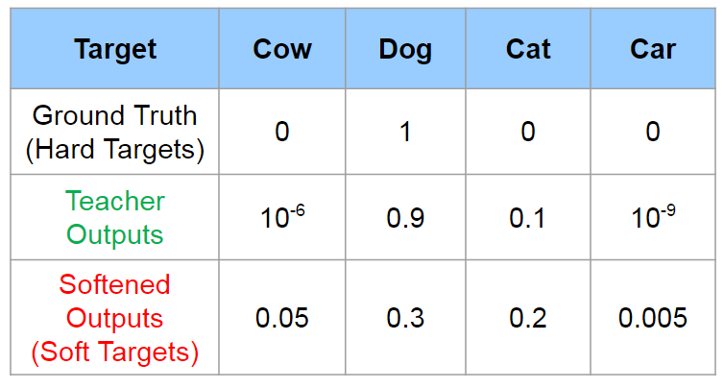
Soft Targets
Adapted from presentation: Dark Knowledge, Hinton, et al. 2014
Notes:
So say we’re training a network for image classification. That is, we’re trying to assign a label to an image.
The ground truth label for an image might look something like this: there’s a single 1 for the correct label, and everything else is 0.

Slide 14
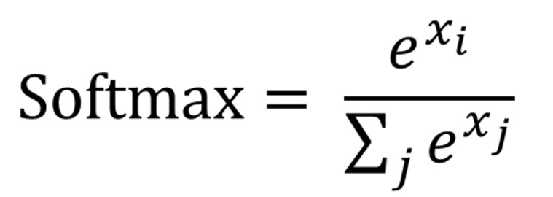
Soft Targets
Teacher Outputs:
Adapted from presentation: Dark Knowledge, Hinton, et al. 2014
Notes:
If you look just at the outputs of a teacher model, because of how the softmax function works, you’ll find that a lot of the times it looks very similar to the ground truth.
There’s a single value close to 1, and everything else is close to 0.

Slide 15
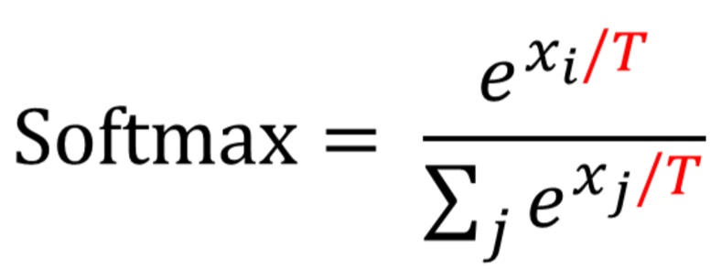
Soft Targets
Teacher Outputs:
Softened Outputs:
Adapted from presentation: Dark Knowledge, Hinton, et al. 2014
Notes:
But, if you soften these outputs by adding a temperature parameter to the softmax, then the values start drawing closer together.
Looking at these values, you can see that the image is most likely of a dog, but it also slightly resembles a cat, and that it’s more like a cow than a car.
To quote, these softened outputs reveal the dark knowledge in the network.
Actually, the same relation exists in the normal outputs, but because the predicted probabilities are so close to 0 the amount of information learned from it is negligible.
So how do we train a student network using these soft targets?

Slide 16
Training Process
Teacher
Input
Softmax
Cross entropy
Label
1. Train teacher model on ground truth label
Notes:
First, you want to have a trained teacher network available.

Slide 17
Training Process
Teacher
Input
Temp
Softmax
Temp
Softmax
Cross entropy
Student
2.1. Transfer teacher knowledge to student model
Loss = Soft_Loss + ...
Notes:
Then, you train the student network by matching its softened outputs with the softened outputs of the teacher.
That is, you want the student to try to match the distribution of the teacher’s outputs
So you take the same input, pass it through both the teacher and the student, pass the outputs through the temperature softmax, and try to get the student to match the teacher.

Slide 18
Training Process
Teacher
Input
Temp
Softmax
Temp
Softmax
Cross entropy
Student
Softmax
Cross entropy
Label
2.2. Train student model on ground truth label
Loss = Soft_Loss + λ Hard_Loss
Notes:
You combine that with trying to predict the correct label as well.
So, the student model is trained from a weighted combination of these losses.
And that’s the entire Knowledge Distillation process, any questions?
Target: 7:30

Slide 19
Experimental Setup
Notes:
Now I'll briefly go over the setup for our experiments

Slide 20
Baseline: AlexNet+SCF
Taking a Deeper Look at Pedestrians, Hosang et al. 2015
Open-source region proposal on GPU - SquaresChnFtrs (Ten years of pedestrian detection, what have we learned? Benenson et al. 2014)
AlexNet to classify patches
Notes:
To keep things simple, we followed the setup in this paper Taking a Deeper Look at Pedestrians.
While they are not quite state-of-the-art, their process is extremely straightforward.
They use a region proposal called Squares Channel Filters to generate potential bounding boxes, and use AlexNet to classify those patches as either pedestrian or non-pedestrian.

Slide 21
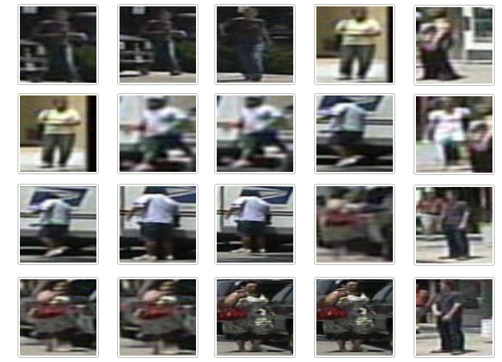
Input
Patches extracted by region proposal and resized to 224x224
Patches Set | Pos | Neg
Training (Every 3 frames) | 31,129 | 748,139
Testing (Every 30 frames) | 916 | 10,505
Notes:
Here are some examples of positive patches from the region proposal.
One thing to note is that there is a lot more negative patches compared to positive patches, so during training we specifically force 25% of each minibatch to be positive patches

Slide 22
Network Design
Notes:
Instead of AlexNet, we decided to use ResNet for our networks

Slide 23
ResNet
Conv
Deep Residual Learning for Image Recognition He et al. 2015
Identity Mappings in Deep Residual Networks He et al. 2016
Max Pool
Tower
State-of-the-art for image classification and very effective for many other domains
Global Avg Pool
Softmax
Neg
Pos
Notes:
In addition to being a lot better than AlexNet, ResNet officially comes in multiple sizes so we used a large one as the teacher and a small one as the student.
The difference in size comes from changing the number of layers in the Tower section in the middle.

Slide 24
Teacher : ResNet-200
Standard Models
3x
24x
36x
3x
Tower
64
128
256
512
Student : ResNet-18
2x
2x
2x
2x
Tower
64
128
256
512
Notes:
These two networks, ResNet-200 and ResNet-18, are exactly as described in the ResNet paper.
A box represent a block of convolutional layers with that many outputs channels, and the number above is the number of those blocks chained together.
So, for example, our teacher model, ResNet-200, has 3 blocks with 64 output channels followed by 24 blocks with 128 output channels and so on.

Slide 25
Student #2 : ResNet-18-Thin
Modified Models
2x
2x
2x
2x
Tower
32
64
128
256
Student #3 : ResNet-18-Small
2x
2x
2x
2x
Tower
32
32
32
32
We cut the number of channels in half (ResNet-18-Thin), and fixed number of channels at 32 (ResNet-18-Small)
Notes:
To get even smaller networks, we tried cutting the number of channels in half everywhere for ResNet-18-Thin and fixing the number of channels at 32 for ResNet-18-Small.
We'll show a comparison of their size and speed later.
So now we have everything set up and can try training our student models with knowledge distillation, and…

Slide 26
Results: Baseline
Model | Direct | KD
AlexNet | 23.3% | -
ResNet-200 | 17.5% | -
ResNet-18 | 19.1% | 18.6%
ResNet-18 Thin | 22.0% | 22.8%
ResNet-18 Small | 24.5% | 24.8%
Notes:
Well, let’s see.
The direct column is the log-average miss rate when trained using just the training data, and the KD column is the student model trained with Knowledge Distillation.
It seems that KD isn’t working?
Noranart will explain what is going on.

Slide 27
Hint Layer

Slide 28
Traditional Knowledge Distillation
Teacher
FC2
Input
Temp
Softmax
Temp
Softmax
Cross entropy
Student
FC2
Teacher guidance with 2 outputs are not enough

Slide 29
Hint Layer
Teacher
2048
outputs
FC2
Input
Student
512
outputs
FC2
Previous layer’s #channel does not match

Slide 30
Hint Layer
Teacher
2048 outputs
Hint FC 2048->64
FC 64->2
Input
Student
512
outputs
Hint FC 512->64
FC 64->2
Add extra fully connected layer to each model

Slide 31
Hint Layer
Teacher
Hint FC 2048->64
FC 64->2
Input
Euclidean Loss
Copy weights
Student
Hint FC 512->64
FC 64->2
Train to match teacher’s hint layer outputs

Slide 32
Results: Hint Layer
Model | Direct | Hint
ResNet-200 | 17.5% | -
ResNet-18 | 19.1% | 18.1%
ResNet-18 Thin | 22.0% | 20.4%
ResNet-18 Small | 24.5% | 23.1%
Notes:
Hint layer exposes more dark knowledge from the teacher model and improves every student model

Slide 33
Teacher Confidence

Slide 34
Dropout as Bayesian Approximation, Yarin Gal, et al. 2015
Training a network with dropout is like training an ensemble of networks
If every network in the ensemble agrees on the same output, these networks are very confident, and the prediction is more likely to be good
Dropout at test time can be used to compute output mean and covariance and measure network confidence

Slide 35
Dropout
Teacher
Dropout
Hint FC 2048->64
FC 64->2
Input
Student
Hint FC 512->64
FC 64->2
Add dropout before hint layer

Slide 36
Teacher Confidence
1:
Teacher
Cache
Dropout
Hint FC 2048->64
Input
2:
Cache
Dropout
Hint FC 2048->64
In practice, the dropout process does not add too much overhead because we save the outputs and only repetitively forward last few layers

Slide 37
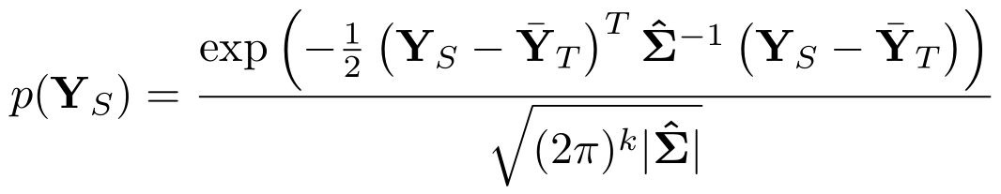
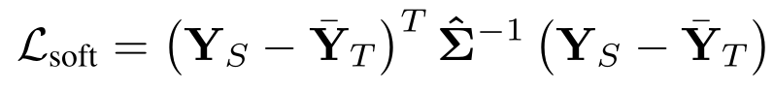
Teacher Confidence
Loss function
We interpret the outputs as samples from a multivariate Gaussian distribution and compute sample mean and covariance
We maximize the log-likelihood of student outputs as being drawn from the same distribution

Slide 38
Results: Teacher Confidence
Model | Direct | Conf | Hint +Conf
ResNet-200 | 17.5% | - | -
ResNet-18 | 19.1% | 18.2% | 18.0%
ResNet-18 Thin | 22.0% | 20.7% | 20.3%
ResNet-18 Small | 24.5% | 23.7% | 22.4%
Notes:
Teacher confidence provides improvement on every student model, and combining teacher confidence with hint layer produces even better results

Slide 39
Handcrafted Features

Slide 40
Auxiliary Network
Handcrafted Features
Student
Input
Softmax
Prediction
Simply add handcrafted features to student model before the deep network (same as traditional computer vision method)
The feature extraction acts like extra frozen layers
These features are very well studied in pedestrian detection

Slide 41
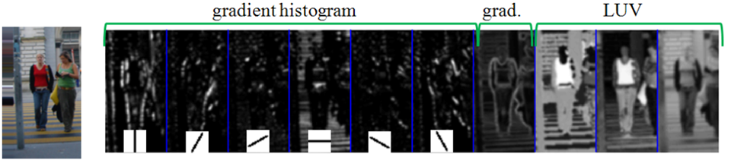
Histogram of Gradients + LUV Color Space
HOG: gradient histogram with 6 orientation + gradient magnitude = 7 channels LUV: color space = 3 channels
Output = 10 x H x W
Integral Channel Features, Dollár, et al., 2009

Slide 42
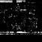
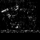
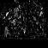

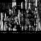
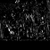
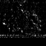
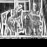

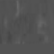
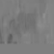
Aggregate Channel Features
HOG+LUV
Aggregate over each patch
Output = 10 x H x W
HOG
Magnitude
LUV
Integral Channel Features, Dollár, et al., 2009

Slide 43
Results: Hand-Designed Features
Model | RGB Direct | ACF Direct | RGB+Hint+Conf | ACF+Hint +Conf
ResNet-200 | 17.5% | 19.6% | - | -
ResNet-18 | 19.1% | 21.4% | 18.0% | 18.7%
ResNet-18 Thin | 22.0% | 22.4% | 20.3% | 20.4%
ResNet-18 Small | 24.5% | 25.2% | 22.4% | 23.4%
Notes:
ACF shows no statistically significant difference compared to RGB in both training directly and with Hint+Conf.

Slide 44
Performance

Slide 45
Performance
Model | Direct | Hint+Conf | #Param | Comp Rate | Speed | Speed Up | Memory | Memory Reduce
ResNet-200 | 17.5% | - | 63 M | 1x | 24 ms | 1x | 5,052 MB | 1x
ResNet-18 | 19.1% | 18.0% | 11 M | 6x | 3 ms | 8x | 612 MB | 8x
ResNet-18 Thin | 22.0% | 20.3% | 2.8 M | 22x | 3 ms | 8x | 308 MB | 16x
ResNet-18 Small | 24.5% | 22.4% | 0.157 M | 400x | 3 ms | 8x | 240 MB | 21x

Slide 46
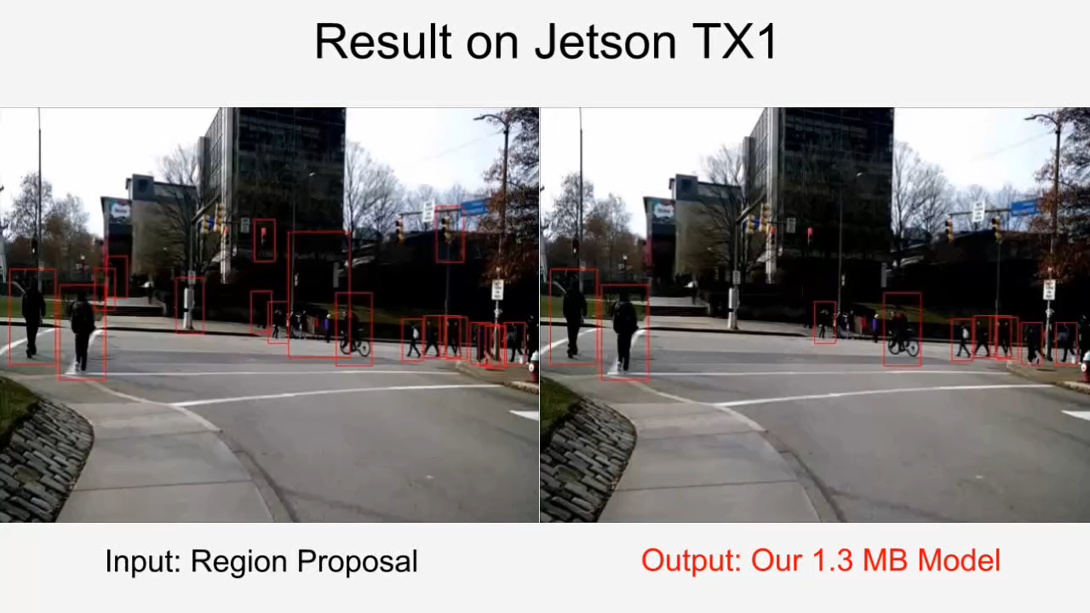
Demo

Slide 47
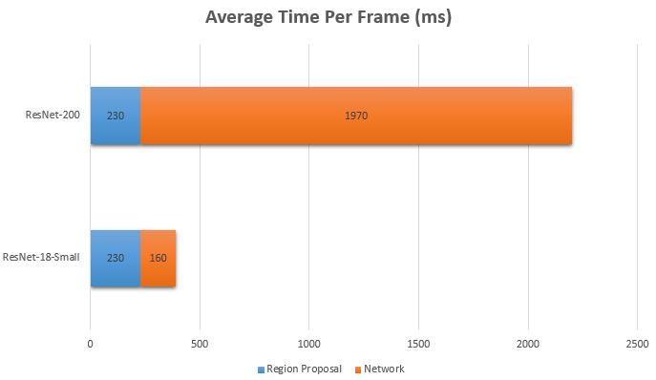
Performance: TX1
Average ~10 region proposals per frame

Slide 48
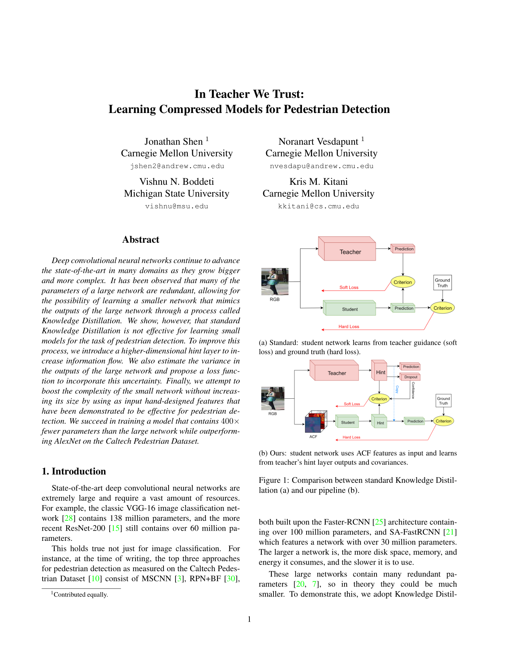
Submission
Submitted to CVPR 2017
“In Teacher We Trust: Learning Compressed Models for Pedestrian Detection”

Slide 49
Pedestrian Detection
For mobile platforms
Jonathan Shen Noranart Vesdapunt
jshen2@andrew.cmu.edu nvesdapu@andrew.cmu.edu
Supervisor Kris Kitani
Sponsor Carnegie Robotics
Carnegie Mellon University

Slide 50
Extra Slides

Slide 51
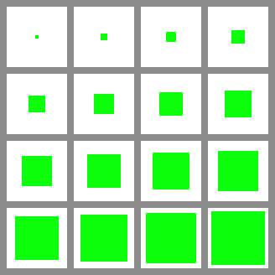
Region Proposal: SCF
SquaresChnFtrs (SCF) is the middle tier of HOG+LUV family (slower than ACF but much higher performance, faster than checkerboards)
Log-avg miss rate (lower is better) - ACF : 44.2% - SCF : 34.8% - SCF+AlexNet : 23.3% - Oracle : 13.2%
Features - HOG+LUV - Integral Channel Features (ICF)
Ten years of pedestrian detection, what have we learned? Benenson et al. 2014

Slide 52
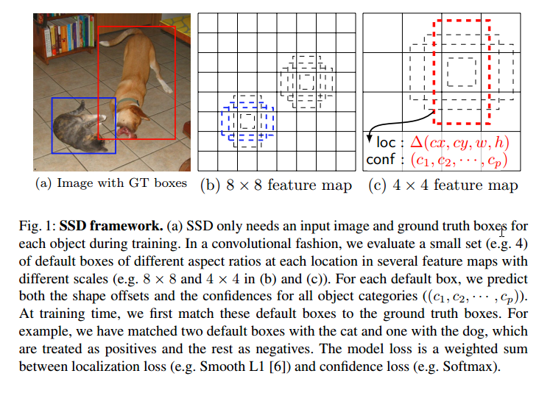
SSD: Single Shot MultiBox Detector, Liu et al.
Use VGG-16 on full image
Predefine 7k box location
Learn box score, box offset
~60fps on 300x300 image on TitanX
Works for Caltech - Fused DNN: A deep neural network fusion approach to fast and robust pedestrian detection, Du et al. 2016

